Slide 1
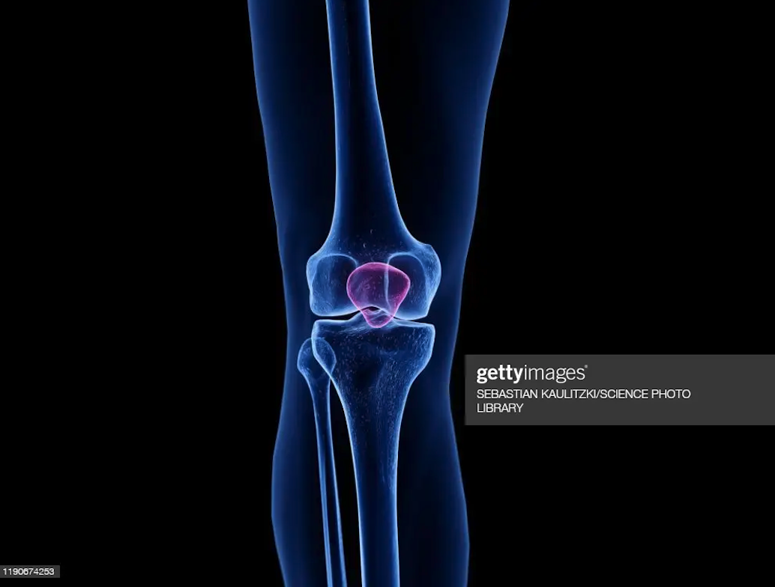
KNEE ANATOMY
PT7001

Slide 2
Learning Outcomes
After this lecture you should be able to:
Describe the bony anatomy of the knee joint, including the shape of the
articular surfaces
Know that the femoral and obturator nerves may refer knee pain to the hip and vice-versa
Describe the patello-femoral joint and list its common clinical problems
Define the terms “genu valgum” and “genu varum”
Know the position, shape and functions of the menisci, and give an
account of their common injuries
Give an account of the movements of the tibiofemoral joints
Describe the ligaments of the knee joint and give their functions
Describe the capsule and synovium of the joint, and list the bursae associated with it. Know the symptoms and signs of inflammation of these bursae
1
2
3
4

Slide 3
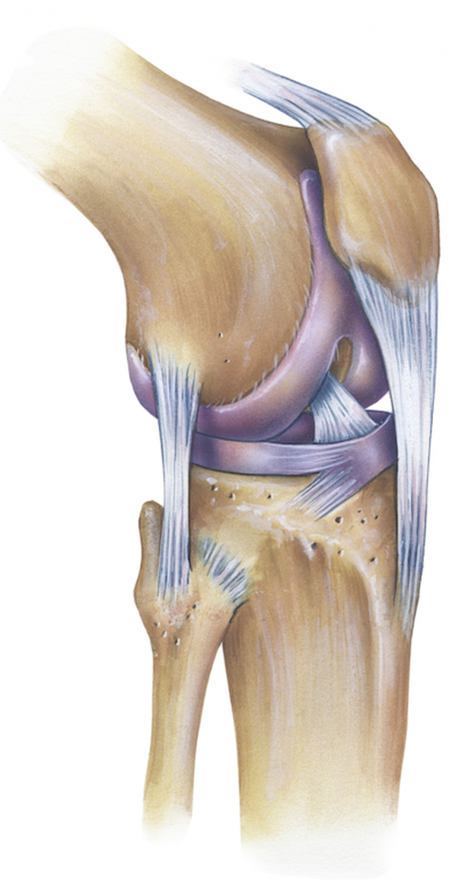
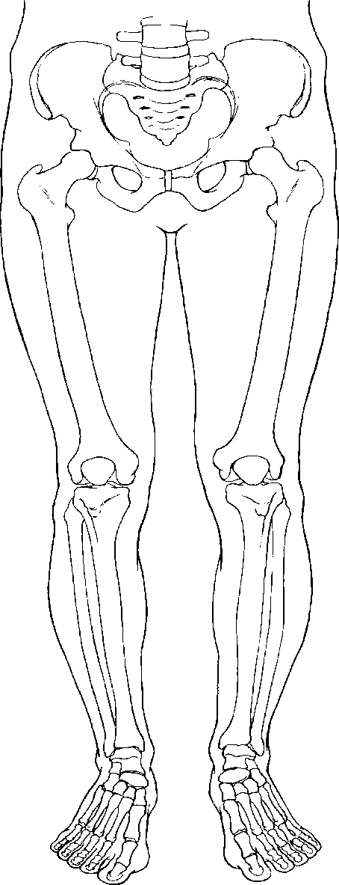
Part 1
Knee Joint
Part 1:
Overview and Knee Dislocation

Slide 4
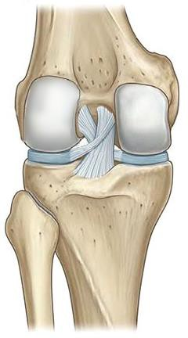
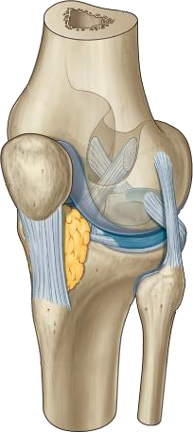
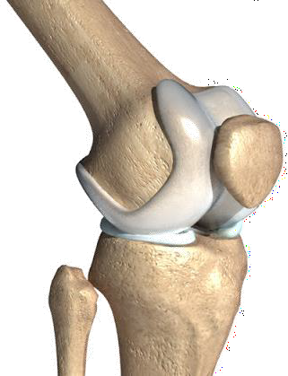
The Knee Joint Overview
Hinge joint (modified)
Stable due to intra & extra-capsular ligaments
Articulation points:
  - patellofemoral joint
  - med & lat tibiofemoral joints
Not ideally congruent - potential for femoral condyles to slip off the plateaus

Slide 5
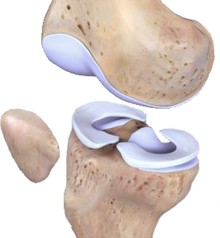
The Knee Menisci
Intra-synovial articular discs
Joint surfaces are made more stable by presence of menisci
Wedge-shaped - help to deepen socket for more congruency, support
Shock absorbency
… more later

Slide 6
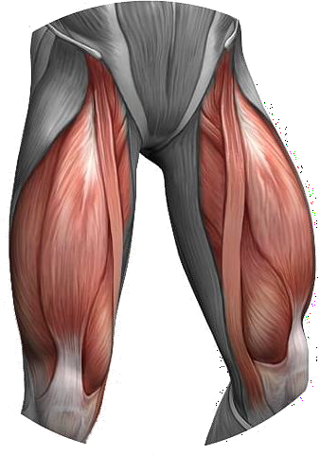
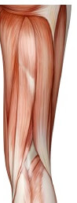
Muscles Crossing the Knee Joint
Produce movement across knee
Enhance joint stability
Anterior - quadriceps group crosses knee via patella - extends knee
Posterior - hamstring & gastrocnemius, popliteus, (plantaris)

Slide 7
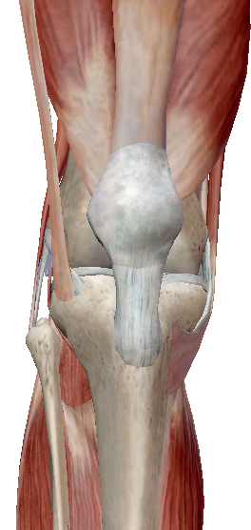
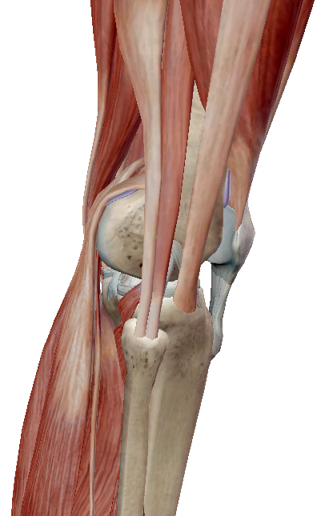
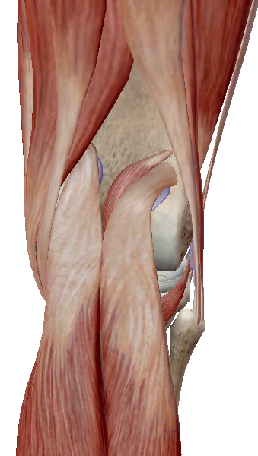
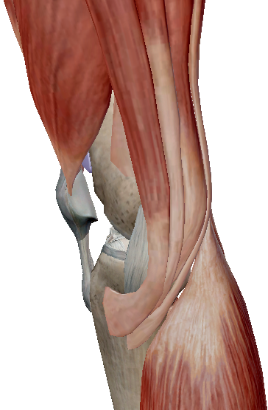
Muscles Crossing the Knee Joint
VL
RF
BF
(L)
ST
VL
VM
BF
(L)
Gr
SM
BF
(S)
ITB
VL
VM
Gr
ITB
ST
S
PL
S
SM
G
Pop
G
G
G
ANTERIOR
LATERAL
POSTERIOR
MEDIAL

Slide 8
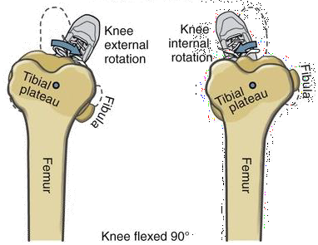
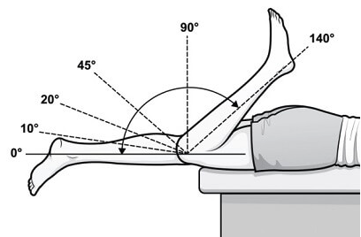
Normal Range of Movements of the Knee
30-40º
10º
Flexion / extension 0 - 135º
Pain, oedema, muscle bulk can restrict
MODIFIED HINGE JOINT

Slide 9
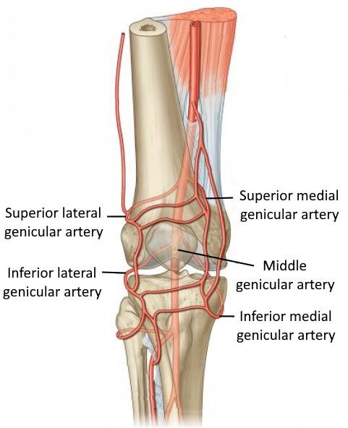
Vasculature of the Knee Joint
Blood supply is from:
  - anastomoses (branches) of the popliteal artery
  - descending branches of genicular arteries (5)
  from hip & thigh (genu = Latin for knee)
  - popliteal artery branches from femoral a.
Popliteal artery
(posterior)

Slide 10
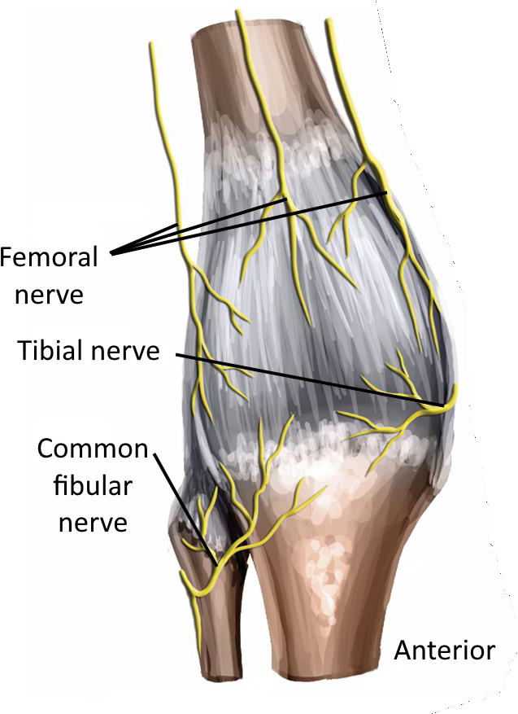
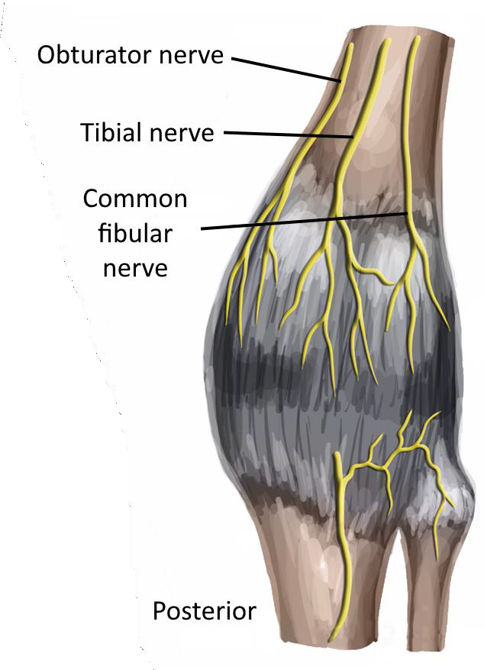
Neurovasculature of the Knee Joint
Capsule is innervated by 4 nerves
Anterior - femoral nerve
Posterior - obturator nerve
- tibial nerve
- common fibular nerves
FEMORAL & OBTURATOR nerves also supply the hip joint so can often get referred pain from one joint to the other

Slide 11
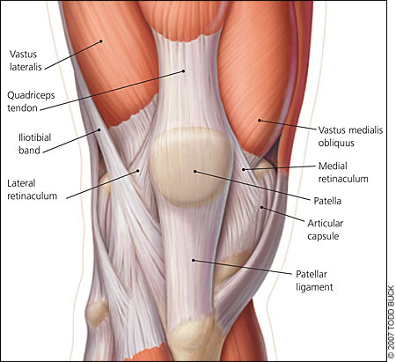
Retinaculae of the Knee Joint
Fibrous bands of thick fascia
Externally to the capsule the knee is supported by collateral ligaments
Patellar tendon acts like a ligament supporting the front of the joint (often ligamentum patellae)
Fat pad behind the patellar T. prevents the synovium from escaping anteriorly - also fills gap
Additional support by the quadriceps tendon continuations crossing downwards over the joint - these are the medial & lateral retinaculae - keep fat pad & synovium in place.

Slide 12
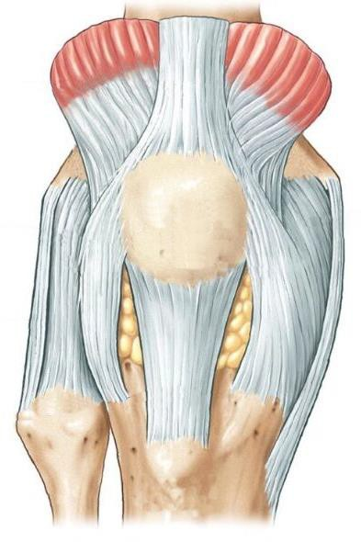
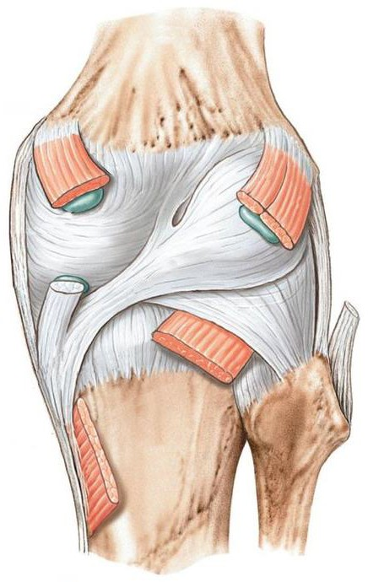
Capsule of the Knee Joint
Posteriorly strong capsule
- supported by oblique popliteal lig. & arcuate lig.
…more ligaments later
Oblique popliteal ligament
Arcuate
ligament

Slide 13
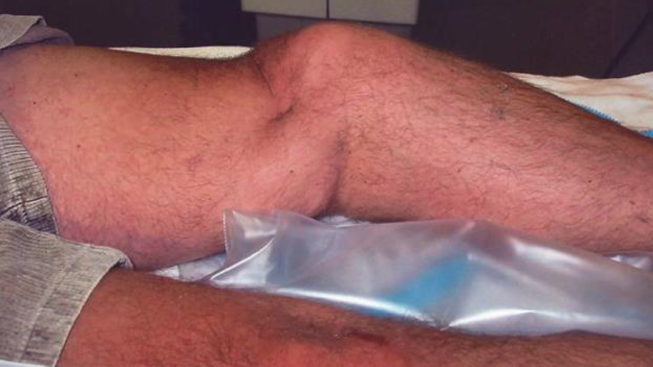
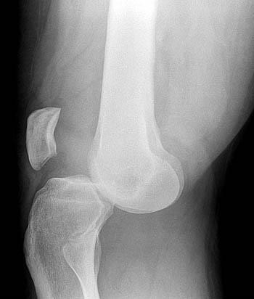
Knee Dislocation
Posterior tibiofemoral dislocation
rupture of 3 or 4 ligaments
popliteal artery at risk

Slide 14
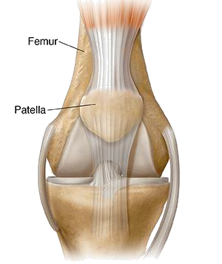
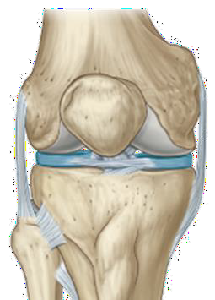
The Patello-Femoral Joints
Patella = sesamoid bone, upside-down triangle (base at top superiorly, apex at bottom)
Quads T. attaches to the base (top)
Patella T. attaches to apex (bottom)
Patella only articulates between the femoral condyles - groove (trochlea). Not at all with tibia.
Med & lat patellofemoral joints at reverse of patella…

Slide 15
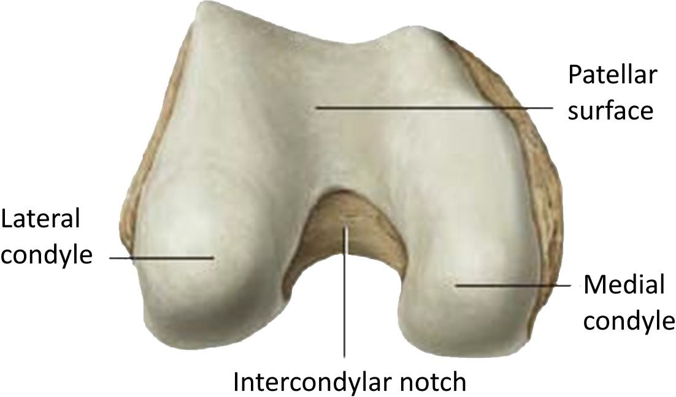
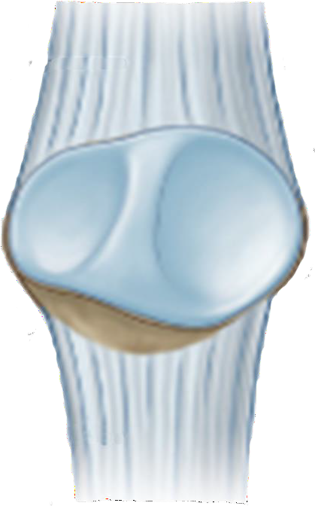
The Patello-Femoral Articular Surfaces
Med & lat articular surface of the patella for each femoral condyle with a vertical ridge in between
Lat femoral condyle projects more anteriorly and is larger - therefore patella articular surface is larger
M
L

Slide 16
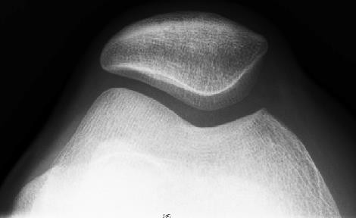
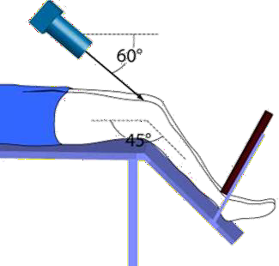
The Sunrise View
Left leg

Slide 17
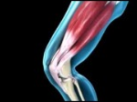

Slide 18
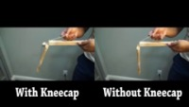

Slide 19
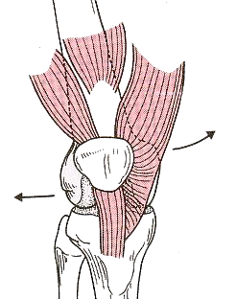
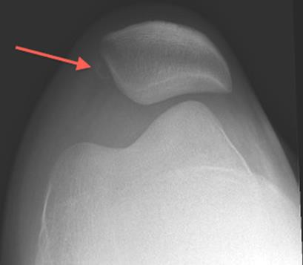
Patello-Femoral Dislocation
Most patella dislocs are lateral as medially the patella is very stable
MOI - sudden medial rotation
In normal knee, quads muscle pulls the patella upwards via the quads tendon - this is in exactly the same direction as the rec fem fibres
- but, vastus lat & intermedius pull the patella laterally → patella potentially deviates & causes disloc
this is prevented by 2 factors…

Slide 20
Patello-Femoral Dislocation
… this is prevented by 2 factors:…
lat femoral condyle is larger
vastus medialis fibres insert almost horizontally to the medial border of the patella to correct the pull of the other muscles
In some sports (e.g. cycling) this medial pull can be too much

Slide 21
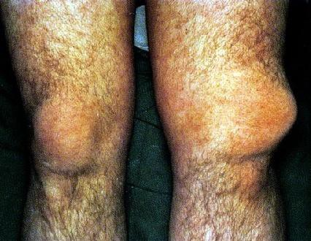
Signs of Patello-Femoral Dislocation

Slide 22
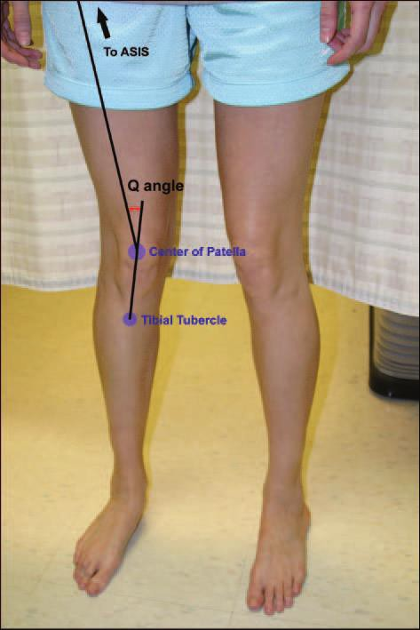
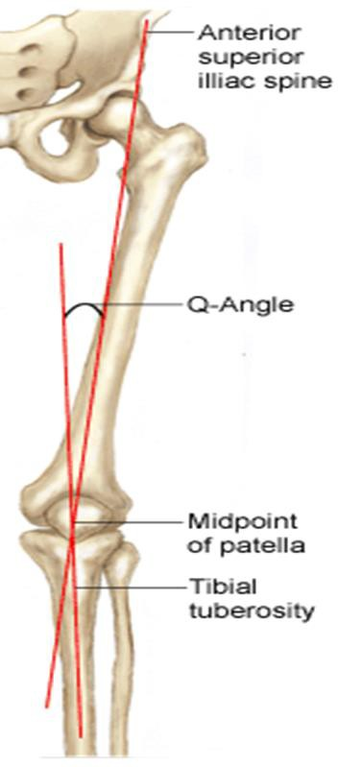
Q-Angle
The femur is angled so the quads muscle pulls along the mechanical axis
Creates an angle across the knee joint - Q-angle (quadriceps angle)
Can also be affected by
- excessively wide hips
- abnormally placed knees (knee valgus,
tibial torsion)
- mal-positioned patella (high-riding
(patella alta) or displaced)

Slide 23
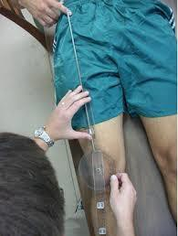
Measuring Q-Angle
Line through the center of the patella to the ASIS and another line from the tibial tuberosity through the center of the patella.
The intersection of these two lines is the Q-angle
Normative value is 13° to 18°
Females have wider hips, so angle is greater
High Q-angle puts enormous strain on the patella (fulcrum, force) = prone to dislocation

Slide 24
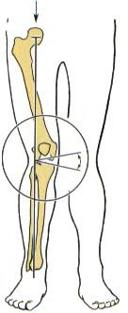
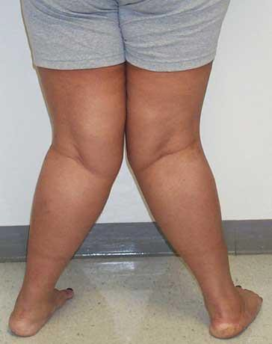
Knee Angles
Genu = Latin for knee
Genu valgum / knee valgus / knock knees
Increased Q-angle
Stresses MCL
Increase pressure on bone & cartilage on lateral side
genu valgum

Slide 25
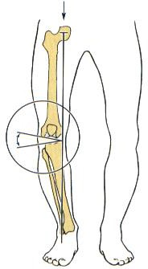
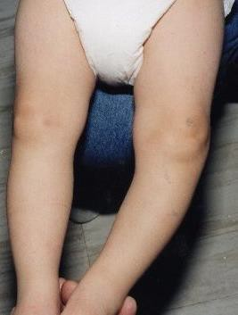
Knee Angles
Genu varum / knee varus / bow legs
Stresses LCL
Can lead to tearing of the meniscus
genu varum

Slide 26
The Knee Joint
Self-Assessment Questions Pt 1
What exactly is the patella, and why is it there?
Name two factors which help prevent patello-
femoral dislocation.
What do the terms ‘genu valgum’ and ‘genu varus’
mean?

Slide 27
Part 2
Knee Joint
Part 2:
Tibiofemoral Joints

Slide 28
Tibiofemoral Joints
Hinge - 2 articulations - med & lat. Femoral condyles with tibial condyles.
Condyles = Greek for knuckle. Tibial condyles misnamed because they are flat plateaus

Slide 29
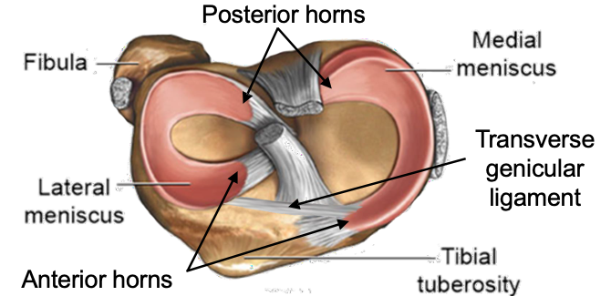
The Menisci
Fibrocartilaginous pads
Compensate for the incongruence of the articular surfaces of the TFJ.
Post & ant horns attach to the sides of the tibial intercondylar eminence
Thicker around periphery - wedge shape
Med meniscus C-shaped, lat is O-shaped
Med meniscus additionally attached to deep part of MCL (why can often injure both structures)
2 anterior horns attached to each other by transverse genicular ligament
Between the anterior horns - attachment of ACL
Between posterior horns - PCL

Slide 30
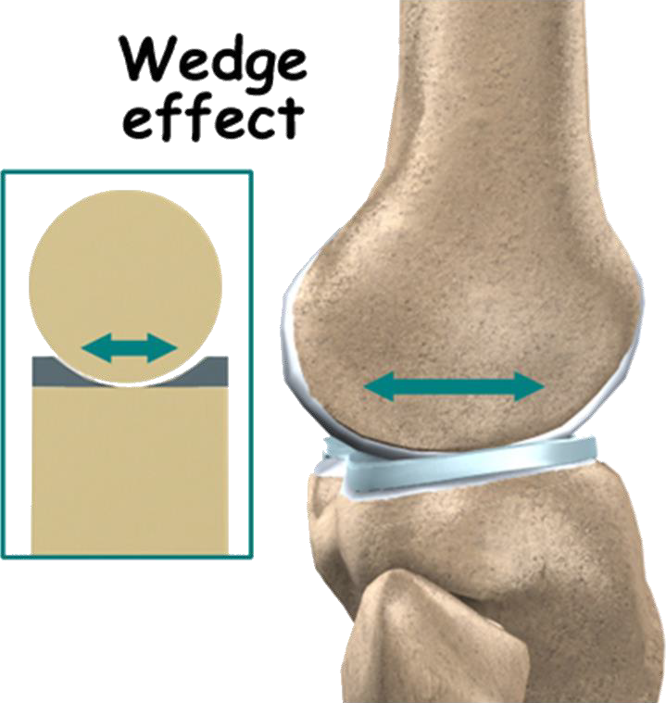
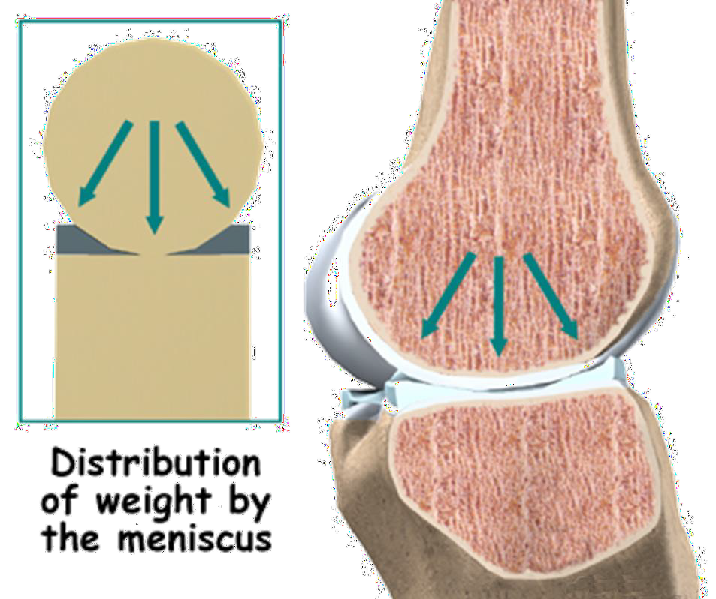
Functions of the Menisci
Increase congruency - stability
Shock-absorbers
Aid lubrication - synovial fluid

Slide 31
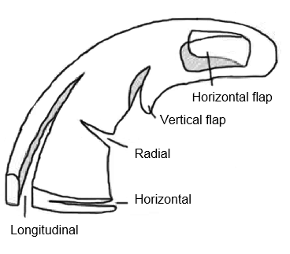
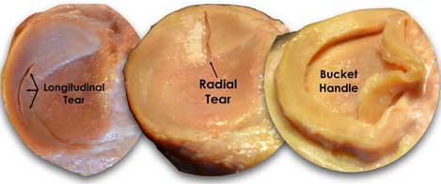
Tears of the Menisci
Common, as menisci are subject to great forces placed upon them
Many diff types of tear - can be along longitudinal, horizontal or radial axis
Lat meniscus is freer to move than med (not bound by lig.) so is less likely to be torn as can adapt to excessive forces. (Med attached to deep MCL)

Slide 32
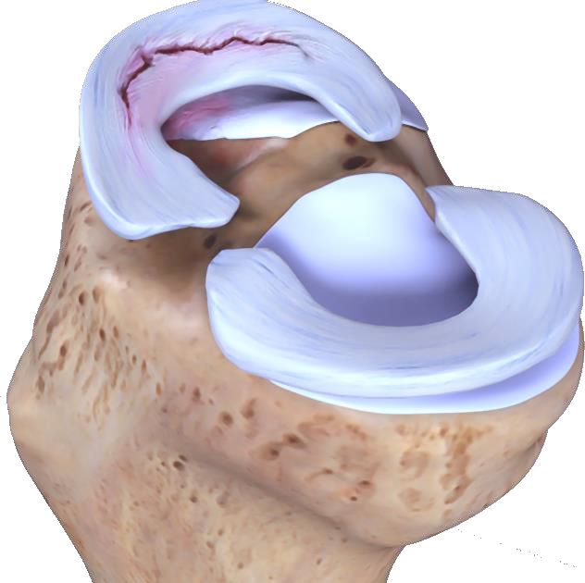
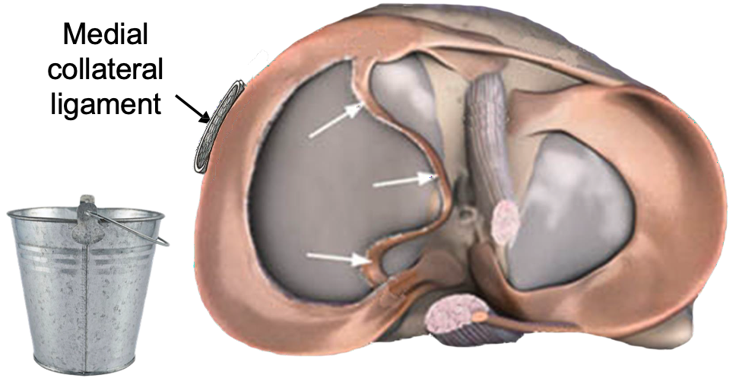
Bucket-handle Tear
Most common tear = bucket handle tear - leaves a medial segment which can flip over - gets in the way of articulations & knee may not fully extend.

Slide 33
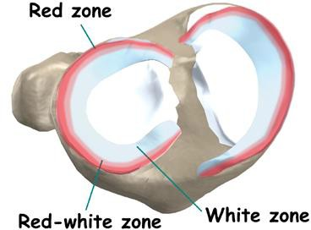
Red Zones of the Menisci
Direct relationship between vascularisation & capacity to heal.
Red zone more vascularised so heals better.

Slide 34
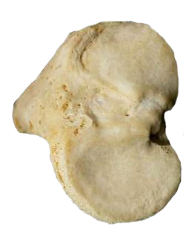

Tibio-Femoral Joint
L
L
A
P
P
A
M
M
Joint is fully flexed and pulled apart
The most anterior part of the fem condyle is reserved for the patella

Slide 35


Tibio-Femoral Joint
During walking, to move from flexion to extension there is a combination of rolling and gliding within this joint
  the lateral side (orange) uses up its articular surface quicker than the medial (green) side
  the medial continues into extension until its surface is used up
  this causes medial rotation of the femur on the tibia in the final 15° of extension
  the rotation causes tightening of all the ligaments
  joint becomes solid and stable = close-packed position

Slide 36



Popliteus Muscle
Once the joint is locked in full extension, it needs to be rotated the other way in order to be unlocked
  the popliteus muscle does this - it laterally rotates the femur
Triangular muscle at back of tibia, inserts into lat femoral condyle and actually pierces the capsule here and attaches inside
  at this point is a thickening of the capsule = arcuate ligament, part of the posterolateral ligament complex
Popliteus is supplied by the tibial nerve

Slide 37
The Knee Joint
Self-Assessment Questions Pt 2
What are the main differences between the medial
and lateral femoral condyles?
Why is the medial meniscus 20 times more likely to be injured than the lateral meniscus?
What is the action of the popliteus muscle?

Slide 38
Part 3
Knee Joint
Part 3:
Ligaments of the Knee Joint

Slide 39


Collateral Ligaments
LCL
thinner cord-like
attached proximally to lateral epicondyle and distally to head of fibula
MCL
flat strap
2 bands
superficial band from med epicondyle of femur & inserts distally onto proximal shaft of tibia
deep band - same but also anchored to medial meniscus

Slide 40

Collateral Ligaments Function
Prevent sideways movement of the joint - against varus or valgus force
Collateral ligaments are taut in full extension & relaxed during flexion
In normal walking it is in extension that body load is applied to the joint so this is when it needs most support
LCL
MCL

Slide 41


Additional support is provided by…
1.
3.
1.
5.
4.
6. also med head of gastroc
2.
Pes Anserinus tendons
(goose foot)

Slide 42


Valgus Stress Test
When seated (knee flexion) there is little support from muscles or ligaments (relaxed), so must test the ligament in extension
Valgus stress test - stresses MCL

Slide 43


Varus Test Stress
Varus stress test - stresses LCL

Slide 44

Cruciate Ligaments
Crux = Latin for cross
ACL - anterior intercondylar ridge of tibia → inserts lateral surface of medial femoral condyle posteriorly HAND IN TROUSER POCKET direction
PCL - posterior intercondylar ridge of tibia → inserts lateral surface of medial femoral condyle anteriorly

Slide 45


Slide 46




TRANSVERSE VIEW
POSTERIOR VIEW
ACL
ACL
PCL
PCL
PCL
ACL
POSTERIOR VIEW
MEDIAL VIEW
ACL
PCL

Slide 47

Anterior Cruciate Ligament
ACL prevents anterior displacement of the tibia in relation to the femur
Is subject to great stress during full extension - taut, and tightened even more by locking mechanism

Slide 48

Posterior Cruciate Ligament
PCL does the opposite - prevents posterior translation of the tibia / excessive fwd movement of femur
PCL approx 3 times thicker than ACL
When walking/running, knee is partially flexed as we begin to transfer body weight onto the limb
at that moment 2 structures are helping to keep the femur from slipping forward…
  PCL
  tightness of the extensor mechanism - quads is contracting = patellar T. stretched firmly across front of joint

Slide 49

Cruciate Ligament Injury
When knee is extended, ligaments are taut - if sudden additional medial twisting when foot is planted → ligaments are subject to injury
ACL thinner so more prone to injury
The ACL receives its blood supply from branches of the middle genicular artery, which form a vascular synovial envelope around the ligament. These periligamentous vessels penetrate the ligament transversely
Both ligaments have vascular zones (inferior geniculate artery) and if ruptured can leak blood inside the joint capsule = haematoma → swelling, pain, discolouration of joint

Slide 50


The Lachman’s Test
Knee at 30° so hamstring relaxed
Evaluates ACL rupture

Slide 51



The Unhappy Triad
ACL + MCL + medial meniscus
from lateral force or twisting in extension

Slide 52
The Knee Joint
Self-Assessment Questions Pt 3
Name five structures which protect the lateral side
of the knee joint?
Which ligament is taut during flexion of the knee?
Which 3 structures are involved in a classical
‘unhappy triad’?

Slide 53
Part 4
Knee Joint
Part 4:
Bursae of the Knee

Slide 54

Synovium of the Knee Joint
The cruciate ligaments and popliteal tendon are inside the capsule - but lie OUTSIDE the synovial membrane (intra-capsular but extra-synovial)
cruciate ligaments get access to a blood supply

Slide 55

Infrapatellar Fat Pad
Infrapatellar fat pad (Hoffa’s fat pad) (intracapsular, extrasynovial) - outside synovium, behind patellar tendon. Synovium sits on top.
Fat pad acts as cushion, prevents friction, fills the gap for stabilisation
Richly vascularised
Infrapatellar
fat pad

Slide 56


Infrapatellar Fat Pad Attachments

Slide 57

Bursae of the Knee Joint
Lots around knee - most protect tendons where they lie close to the bone
Prepatellar bursa protects the skin
4 in continuity with joint - suprapatellar, semimembranosus, gastrocnemius, popliteal
Commonly the semimembranosus bursa & the gastrocnemius bursa are combined
Medial view

Slide 58


Popliteus Bursa
Protects the popliteal tendon as it winds laterally under LCL to reach the lateral epicondyle of femur
Enlargement of these bursae - inflammation → swelling = Baker’s Cyst
Can occur following any knee inflammation, but is commonly associated with inflammatory reaction in late stages of osteoarthritis of knee

Slide 59


Popliteal (Baker’s) Cyst

Slide 60


Anserine Bursa
Most common bursa to be affected by running - constant friction, excessive rotation, valgus stress

Slide 61


Suprapatellar Bursitis

Slide 62

Pre-Patellar Bursitis

Slide 63


Infrapatellar Bursitis

Slide 64


Treatment for Bursitis
Excess fluid removed by aspiration, and NSAID agents are used to treat the inflammation

Slide 65
The Knee Joint
Self-Assessment Questions Pt 4
Name four bursae that are continuous with the
cavity of the knee joint.
Which bursa may be inflamed if there is pain on the medial side of the joint?
Which bursa is inflamed in Clergyman’s Knee?

